Slide 1

Status 04.07.2022 — Afternoon
Work Group “Information Travel and Pandemics”

Slide 2
Requirements
Chose one of the figures to reproduce
Find parameters that can influence the model
Create a hypothesis
Find characteristics to measure information impact

Slide 3
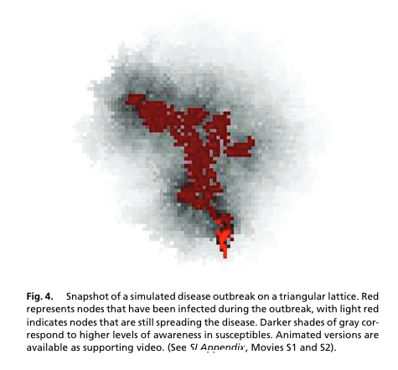
Paper of choice
FUNK, Sebastian, Erez GILAD, Chris WATKINS und Vincent A. A. JANSEN, 2009. The spread of awareness and its impact on epidemic outbreaks. Proceedings of the National Academy of Sciences of the United States of America. 21 April 2009. Bd. 106, Nr. 16, S. 6872–6877. DOI 10.1073/pnas.0810762106
We are working to reproduce Figure 4

Slide 4
Provisional Hypothesis
For a low detection rate (creating information from infections) a combination of a high rate of transmission for information, high rate of protection (reducing susceptibility) and a low dampening of information (both over distance and time) will lead to outbreaks being contained by the information. Introducing some non-local spreading of the infection can cause a non contained spreading of locally contained clusters of infections.

Slide 5
What we are trying to do
In our model we try to give people the SIR states in addition to their state of the information strength.
People with a strong information strength are less likely to get infected.
Information wanes with time and distance.
We are working on a grid with four contacts for every person

Slide 6
What our goal for today was
Finishing the first implementation of our chosen model

Slide 7
What we did
SIR model finished
still need to include the grade of information -> idea and working on it
awareness model in the making

Slide 8
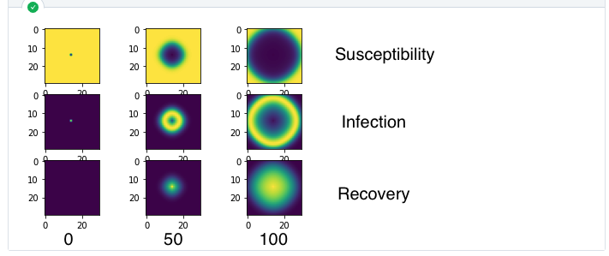
SIR model

Slide 9
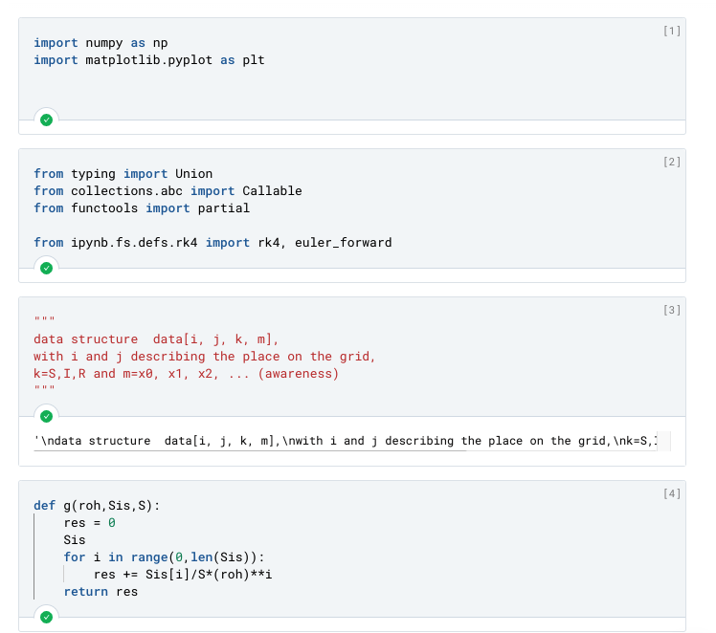
Code

Slide 10
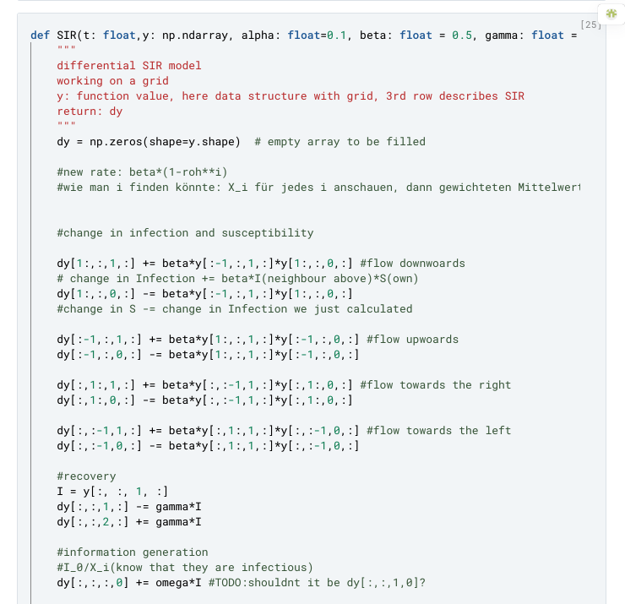
Code II

Slide 11
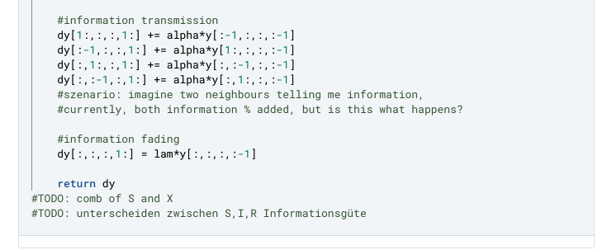
Code III

Slide 12
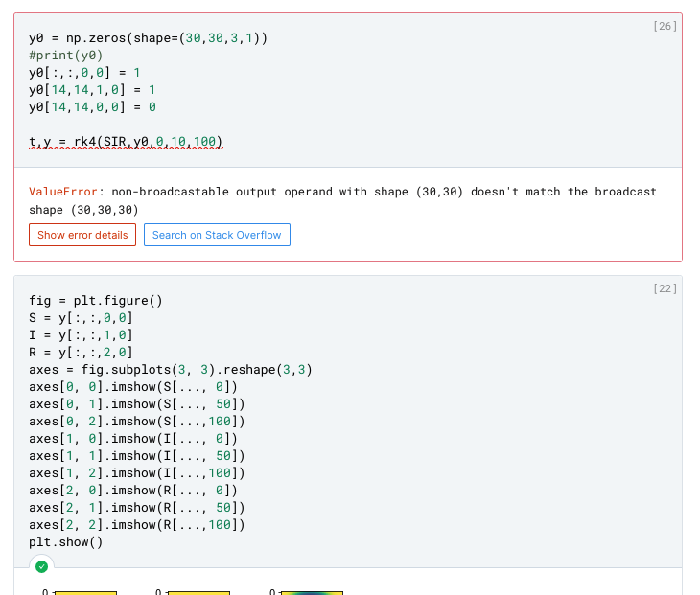
Code IV

Slide 13
Plans for next monday
Implementing one (or more) models for information quality

